Slide 1
Blockchain for the management OF INTERNET RESOURCES
PhD. Defense
Candidate: Stefano Angieri
Co-Supervisor: Marcelo Bagnulo Co-Supervisor: Alberto Garcia Martinez

Slide 2
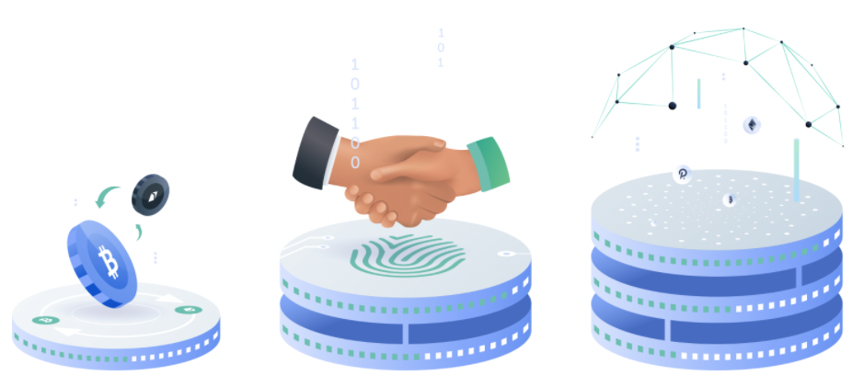
Introduction : Blockchains in nowadays society
«The measure of greatness in a scientific idea is the extent to which it stimulates thought and opens up new lines of research» [Paul Dirac]
[1]
1st Bitcoin
2nd Ethereum
3rd Ethereum 2.0, Cardano,
Polkadot, Solana, BSC, Polygon…
Notes:
If I want to open the intrdocution with this reflection from DIRAC is beacuse Since the revelation of Bitcoin in 2009 Blockchains have become a mainstream discussion topic and have been constantly evolving over the time
---In 13 years we can already count with 3 different generation of blockchains .
-----1-gen designed to improve the financial systems in place with a decentralized monetary platform
to perform transactions between two untrusted parties without the need of an intermediary. «designed to put the control back in the hands of the people.»
------2-gen came adding a layer of “conditions” to transactions, so that people can agree on terms in smart contracts rather than relying on intermediaries
-----3-gen needed to resolve flaws including scalability and interoperability to sustain mass adoption and not suffer slow transaction time and closed systems.
Blockchian is commonly associated with Bitcoin and cryptocurrency and while that’s not wrong, there’s a lot more to the tech than digital currency.
The future of blockchain and its use-cases is tremendously exciting and we’re only just seeing where it can go.

Slide 3
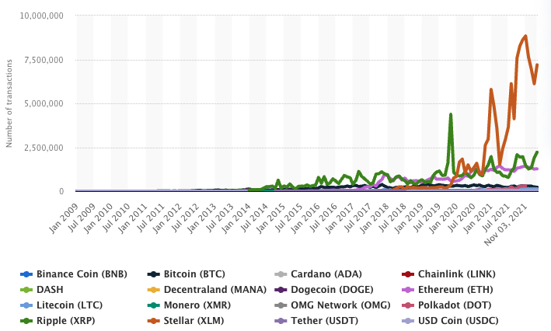
Introduction : Blockchains in nowadays society
Number of daily blockchain transactions in 15 cryptocurrencies
Market Cap:
US$ 2.6 trillion for 5,840+ cryptocurrencies.
2021 Processed Transactions:
Ethereum 1.28 million
Bitcoin 293,000.
[2]
Notes:
Let's now provide some numbers to the nowadays blockchain utilisation
Financial institutions to save $20 billion per year in cross-border payment costs, settlement, and regulatory.
The 4 time eth trans show even how new generation leads to mass adoption. From 20 tx per s up to 3000 tps to 100,000 tps ---All of these number have been possible thanks to the standardad agreed by the whole community
Standards leds to mass adoption. ERC20 Tokens for DAOs Decentralised Autonomus Organizations
NFTs: Digital Art, Gamining,
Ethereum enables the deployment of a decentralized au- tonomous organization (DAO) [26], an organization that is fully implemented in the form of one or more smart contracts without any human involved in the daily operation of the organization. In particular, the bylaws of the organization are embedded into the code of the smart contracts. DAO’s financial transaction records and program rules are maintained on the blockchain.
A smart contract is a deterministic programme that executes business logic in response to event and that is stored and run in the blockchain.
Smart contracts first proposed in 1994 by Nick Szabo within "Bit Gold" in 1998.
First Time in human history that two parties can setup a business, without the need of a trusted third party, codifying the of law of their agreement into blockchain smart contracts.
One of the most exciting application of the blockchain is the DeFi or decentralized Finance
The total locked value has skyrocked in the last year with a peak of 280+ b
1. Money transfers
2. Financial exchanges
3. Lending
4. Insurance
5. Real estate
6. Secure personal information
7. Voting
8. Government benefits
9. Securely share medical information
10. Artist royalties
11. Non-fungible tokens
12. Logistics and supply chain tracking
13. Secure Internet of Things networks
14. Data storage
15. Gambling

Slide 4
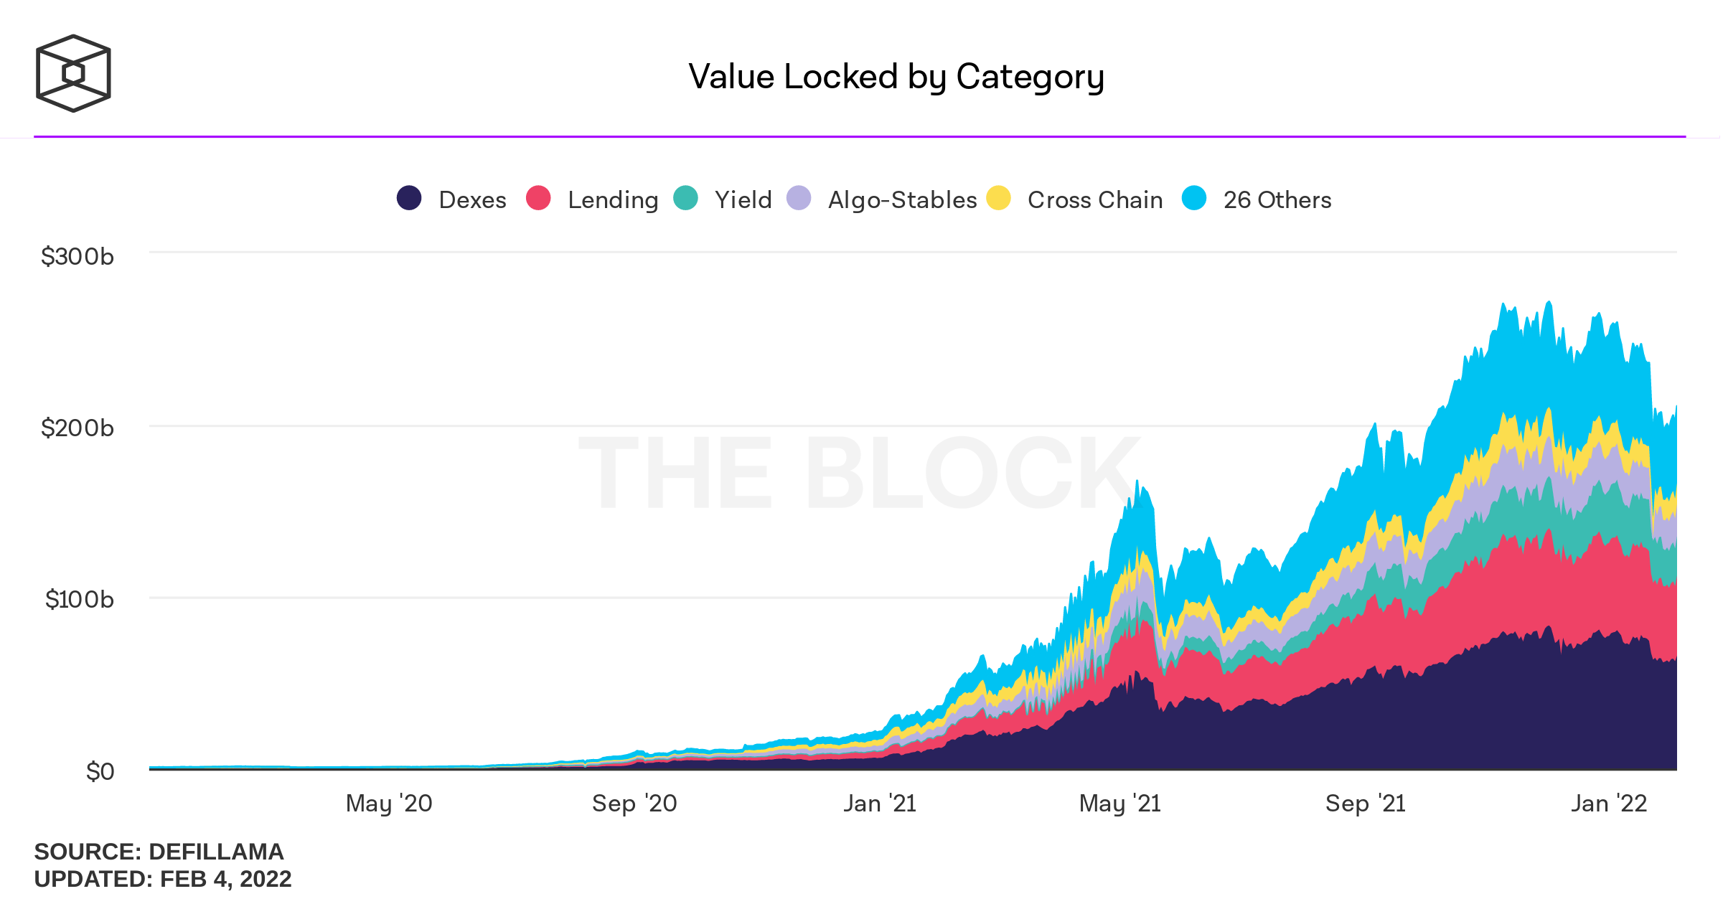
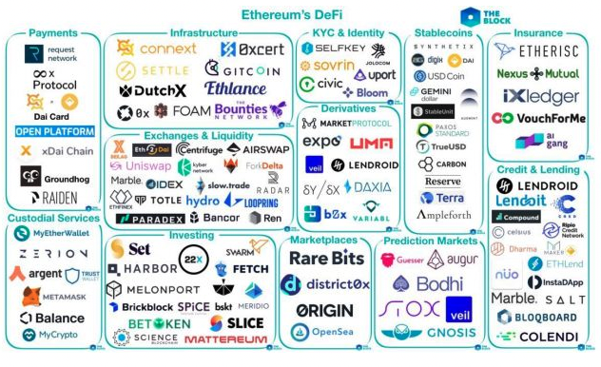
Introduction : Blockchains in nowadays society
Standards
ERC20
ERC721
ERC1155
[4]
[3]
Notes:
All of this has been possibile even thankt to the Standards that came by the community.
NFTs revolutionining DISTINC SECTOR Digital Art, Gamining, Alfa Romeo Car
-- Those standard have promoted one of the most Exciting application : DeFI
---All those protocol are backed by a total liquidity of almost 290 b dilloarsb
1. Money transfers
2. Financial exchanges
3. Lending
4. Insurance
5. Real estate
6. Secure personal information
7. Voting
8. Government benefits
9. Securely share medical information
10. Artist royalties
11. Non-fungible tokens
12. Logistics and supply chain tracking
13. Secure Internet of Things networks
14. Data storage
15. Gambling

Slide 5
Introduction : Blockchains in scientific research
Citation:
Bitcoin (2009) : 17918
Ethereum (2014) : 2584
«The Internet Blockchain: A Distributed, Tamper-Resistant Transaction Framework for the Internet» [A.Hari2016]
«An analysis of the applicability of blockchain to secure IP addresses allocation, delegation and bindings» [J.Paillisse2018]
«An empirical study of Namecoin and lessons for decentralized namespace design» [H.Kalodner2015]
Notes:
--From a scientific point of view Bitcoin first and then Ethereum have had a huge impact in research.
-----In the scientific research we can find examples like:
---------All of this work has inspired that thesis, building new blockchain
Blockchains, as a new general purpose technology yet in an early stage of development, exhibit a potential to disrupt everyday life comparable to computers or Internet itself.
The application of the technology to the management of the Internet resources result naturally from the convenience to provide a fair and predictable, transparent, automatic and efficient framework.

Slide 6
Outiline
InBlock
InBlockIPv6 Proof of Concept
InBlockIPv4 Proof of Concept
IRB & ASIRIA
Internet Routing Blockchain
Autonomous System Internet Registry Inference for path Authorization
Conclusions & future work
Notes:
Let's take a look on what we are going to see during this presentation
The first study we are going to present ----InBlock. Challenges and Motivation that inspired our work.
Then its design, and its two PoC with their practical evaluation ---Then we will move to the IRB and ASIRIA.
Even in this case we will see challenges and motivation that inspired our work. Then boths design, and experimental evaluation
--- We will finally present the conclusions and the future work.
--A DAO deºfined in a set of Smart Contracts (SCs) running in the Ethereum blockchain. performing the functions of an IP address registry, as defined by [85].
--IRB permissioned blockchain based framework for the management and storage of the resources registered in more than 34+ different IRRs
---ASIRIA Route Leaks Detection and Prevention mechanism using the information stored in IRRs

Slide 7
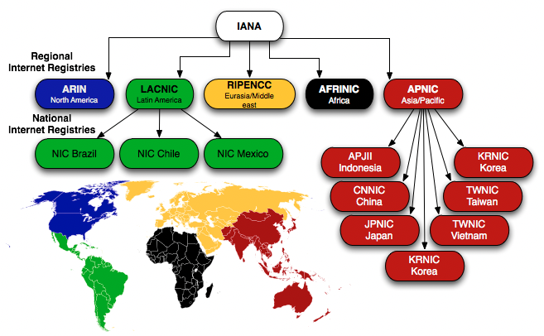
InBlock : Motivation
ICANN
[5]
Notes:
IP ADDRESSES are a cornerstone of the Internet. Every dvice to be able to send and receive packets through the Internet. The way these resource are managed has an enourmous importance for the correct functioning of the Internet.
---The global pool of IP addresses is managed through a hierarchical structure rooted in the ICANN Internet Corporation for Assigned Names and Numbers ----IANA Internet Assigned Number Authority a department of ICANN
--- One recurring concern is that this structure results in the jurisdiction of some countries (where the ICANN and the RIRs are hosted), overflowing into all the other countries served.
---- This implies that for most countries in the world, the management of a critical resource such as IP addresses operates under the legal framework of a foreign country.
-----The ICANN and the RIRs are private or- ganizations that operate within the legal framework of the coun- tries where they are based. However for a large set of countries. This also implies that, for most countries, ANY LEGAL ACTION involving IP address management is settled in a FOREIGN COUNRTY LAW
Show Prfexi Hijack Attacks
The administrator of each network then assigns IP addresses to the nodes at the network. The assignment process must consider the limitation of the pools at the time of allocation, and the need to ensure uniqueness and proper registration to meet several operational requirements [43,44].
In the early days of the Internet, University California - the responsibility for assigning and managing the global pool of IP addresses was performed by the University of Southern California as part of a research project funded by the Defence Advanced Research Projects Agency (DARPA), U.S. government. Between 1998 and 2016, the National Telecommunications and Information Administration (NTIA), part of the Department of Commerce, U.S. government, outsourced the technical management role to the Internet Corporation for Assigned Names and Numbers (ICANN). In 2016, Internet stakeholders, including the U.S. government, agreed to let the contract with the U.S. government expire and ICANN continued to perform the management of the global pool of Internet addresses, numbers and names ever since [45]. Although ICANN’s structure seeks for accountability and transparency, ICANN is ultimately subject to the jurisdiction of the California State, in which many lawsuits have been filed [46].
ICANN has delegated the address management duties to the five RIRs, namely AFRINIC (Africa), APNIC (Asia Pacific region), ARIN (mainly US and Canada), LACNIC (Latin America and the Caribbean) and RIPE (Europe, Middle East and Central Asia). RIRs are open membership-based bodies composed primarily of organizations that operate networks. The address resources received from ICANN are assigned according to policies developed regionally by each RIR, although coordinated with the rest.

Slide 8
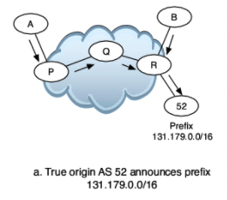
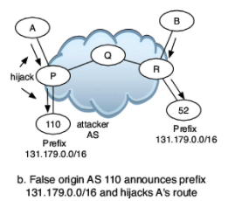
InBlock : Motivation
Prefix Hijacking
[6]
Notes:
-The Traffic is routed through the Internt via the BGP, the protocol to exchange prefix reachability information between the different networks, that in its original specification lacks of security features, ENABLING the unwanted manipulation of routing information. For example prefix hijack
LEGITTIMATE AS 52
---In some parts of the Internet, the false path replaces the authentic route to the prefix and traffic that follows the false path will eventually be dropped or delivered to someone who is pretending to be the legitimate destination.
Others attacks : traffic (blackholing) - (man-in-the-middle) - impersonated (imposture)
Then, the resources are allocated to their requesters, according to six goals explicitly agreed among all RIRs in its policies [17,47–50]:
Uniqueness. Addresses must be globally unique, the “raison d ́être” of the registry.
Fairness. Current policies are designed to be fair, in the sense that they should be equally applied to all parties irrespectively of “their location, nationality, size, or any other factor” [17].
Conservation. A main goal of the Internet resource allocation policies is to make a rational use of them and avoid wasteful practices.
Aggregation. The core routers of the Internet networks exchange information about the Internet address space assigned to each network to perform the global routing function. In particular, these routers must store and process advertisements for the prefixes that describe the address space assigned to every network, so the advertisement of a route can be accounted as an externality [44]. The lower the number of prefixes exchanged, the lower the hardware requirements imposed to all the routers participating in the interdomain routing system. The allocation policies aim to reduce the number of prefixes advertised by fostering hierarchical allocation to some extent. In particular, allocation policies encourage the use of provider-based address aggregation as a preferred choice, by giving large address blocks of so-called Provider Aggregatable (PA) addresses to network providers, which in turn suballocate them to end users. In this way, the routes to many different end users can be advertised by a single announcement that encompasses the address space of the suballocated blocks, thus reducing the number of entries to store and process in the core routers. RIRs may also perform Provider Independent (PI) assignments directly to end-users, usually smaller, although at the risk that they may be unreachable due to network operators not assuming the cost of routing them [51].
Registration. Contact and other information associated with allocations is stored to help the normal operation of the Internet, such as serving to troubleshoot connectivity incidents. The current Internet Assigned Number Authority (IANA)/RIR based system maintains both a private and a public database with information regarding the allocations: first, any registry allocating an address block keeps (internal) records on the party receiving the resources. This typically involves a contract which includes detailed contact information. This information is private and it is not used for Internet operations. It can be used for legal purposes as long as the legal actions are valid within the legal context of the host country. In addition, the party obtaining the resources may use any of the available Internet Routing Registry (IRR) to publish contact and technical information related to the resources. However, the information stored in the IRR system is often incomplete or inaccurate [52].
Minimized overhead. The allocation system should work with as little overhead as needed to fulfil its function.
RIRs can allocate PA blocks to Local Internet Registry (LIRs), and they may also provide direct PI assignments directly to end-users. All RIRs define a minimum PA IPv6 allocation of /32 [17,47–50]3. The allocations can be (much) larger if the applicant justifies the needs. In particular, the larger allocations so far are /20. The minimum PI allocation is a /48 or a /56 depending on the RIR and they can be larger if justified.
RIRs charge a yearly membership fee to entities holding Internet resources. In all RIRs except for RIPE, fees vary according to the amount of resources received. A /48 PI allocation fee is between US$ 100 and US$ 800, depending on the RIR. A /32 PA allocation fee ranges between US$ 1,000 and US $ 2,500. See figure 2.3 for

Slide 9
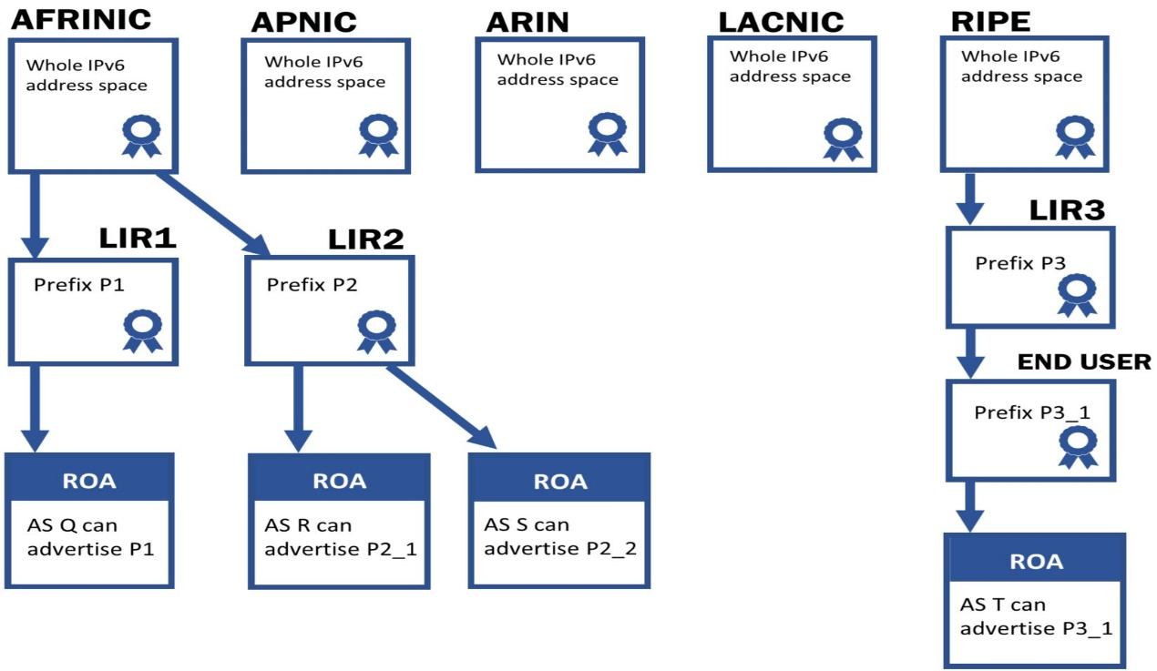
InBlock : Motivation
RPKI & ROAs
Deletion
Suppression
Corruption
Modification
Revocation
Injection
Notes:
-- New security tools, (RPKI) (BGPsec) (ROAs origin validation. Distributed repository with publications points containing the TRUST CHAINS OF route origin authorizations (ROAs) and X.509. HIERACHICAL --- In Previous Work CERTIFICATE ISSUER CAN MANIPULATE AT WILL, the contents of their publication
First 3 by parent CA and on Pubblications Points
Second3 by Corruption of the private key and parent CA
-- Deletion iREMOVE OJBJETCT FROM PUBLICATIONS POINTS AGAINST RESOURCE HOLDER WISHES.
--Modification is the publication of a NEW VALID OBJECT DIFFERENT than one APPROVED BY RESOURCE HOLDER
These tools aim to provide crypto- graphic guarantees that whoever is claiming to have an Inter- net addressing resource is indeed the legitimate holder of the resource according to the defined allocation rules, thereby pre- venting prefix hijacking attacks and other vulnerabilities.
-- Suppression FALIGIN TO DELETE OR PUBLISH OBJECT ACCORDING RESOURCE HOLDER WISHES.
--Corruption is the MODIFICATION OF OBJECT WITHOUT VALID SIGNATURE
--Revocation :INCLUDE certificate IN Certificate Revocation List, NO PERMISSION RESOURCE HOLDER
--Injection: NEW VALID object into a publication point, NO PERMISSION RESOURCE HOLDER.
These actions can be taken against the CA certificates, the ROAs, the manifest and the revocation list.
The three first actions can be performed by the publication point of the objects of the resource holders. The latter three actions require compromising the private key of the resource holder. Also, all of them can be executed by a parent CA. For a more detailed description of the possible actions, the reader is referred to [59].
Moreover, because each RIR currently has a root certificate for the whole IP address space, any RIR can issue valid cer- tificates for any IP prefix. This means that an RIR can issue a certificate for prefix for which another (valid) certificate, rooted on a different RIR, exists. For example, although prefix P was assigned by RIR_A to an entity in its region, out of its own ad- dress pool, and a certificate rooted at RIR_A for prefix P exists, RIR_B may issue a conflicting certificate for the same prefix.
We now describe the set of adverse actions that can be carried out against the different components of the RPKI. In the context of the RPKI, an adverse action is defined as a modification of the information published by the RPKI regarding a set of prefixes that is against the wishes of the holder of the resources. There are different forms of adverse actions [15].
Deletion is the removal of an object from the publication point, against the wishes of the resource holder.
Suppression is failing to delete or publish an object according to the resource holder wishes.
Corruption is the modification of an object without including a valid signature. The object will not pass the signature validation checks.
Modification is the publication of a new valid object that is different to (and replaces) the current version approved by the resource holder.
Revocation of a certificate, so that the object will not pass the signature validation checks. This is achieved by including the certificate in the the appropriate certificate revocation list, without permission of the resource holder.
Injection is the creation of a new valid object into a publication point, without permission of the resource holder.
These actions can be taken against the CA certificates, the ROAs, the manifest and the revocation list. The three first actions can be performed by the publication point of the objects of the resource holders. The latter three actions require compromising the private key of the resource holder. Also, all of them can be executed by a parent CA. For a more detailed description of the possible actions, the reader is referred to [15].

Slide 10
InBlock : Motivation
Provide a decentralised non hierarchical alternative for Internet Resources Allocation Management.
Provide a decentralised non hierarchical alternative to RPKI compatible with BGPsec using blockchain.
Protect entities obtaining a resource allocation from errors and abuses from other entities in the allocation hierarchy
Notes:
To resume ON 3 and even providing a solution to the jurisdicional law concern that we have seen before].

Slide 11
InBlock : Design
A DAO defined in a set of Smart Contracts (SCs) running in the Ethereum blockchain.
Trust model in which only a majority of the involved entities can revert or subvert an existing allocation.
Distributed
Automatic
Irrevocable and tamper-free
Publicly accessible
Notes:
that performs the functions of an IP address registry,.
is an organization represented by rules encoded into a set of smart contract, which is controlled by the organization members that can express their preferences via a voting mechanism and that is not influenced by a central government.
Being blockchain based it inherits by design a list of property
NOT PROPOSING CHANGE BUT COEXISTENCE
---In a nutshell, InBlock works as follows: InBlock has a block of globally routable IP addresses to allocate. To request an address allocation, an entity transfers a fee to InBlock.
--Once the fee transaction has been verified, InBlock annotates in the blockchain the prefix allocated to the requester, serving as a ledger of the address assignment for any interested party accessing to the blockchain.
--Note that, following the paradigm of code is law, the organization bylaws are defined in the InBlock code and executed in the same way by any node validating the blockchain.
-----The human action is limited to the initial definition of the allocation rules (before the InBlock is executed in the blockchain).
----As a blockchain-based organization, it is not controlled by any single entity, so when applied to IP address management, it results in a mechanism that reflects more accurately the current Internet reality as a global network.
performing the functions of an IPv4 address registry.
The InBlock is a DAO that performs IPv6 address alloca- tion registry functions. By autonomous, we mean that the whole organization lies in the blockchain, in the form of smart con- tracts running in the blockchain without human intervention. It is decentralized because the smart contracts run on the nodes that are part of the blockchain. The behavior of the registry is governed by the code of the smart contract. Modifications to the information regarding the registry of IPv6 address blocks are triggered by blockchain transactions and are subject to the consensus mechanism of the blockchain. Therefore, the smart contracts define what a valid transaction is, and, then, all the nodes of the blockchain will enforce that only valid transactions modify the address allocation registry information.
Hereby, as a solution for the above mentioned problems, we discuss the general design of InBlock, a Distributed Autonomous Organization (DAO) for managing IP addresses. The proposed approach uses blockchain technology to perform IPv6/IPv4 address registry functions. InBlock makes different trade-offs than the current hierarchical allocation system. First and most importantly, InBlock is not centrally controlled, but as any blockchain-based mechanism, it depends on distributed consensus. Second, InBlock operates completely autonomously, without any human intervention. InBlock provides a distributed, automatic, irrevocable, tamper-free, publicly accessible and privacy-preserving resource allocation mechanism, designed with the appropriate (economic) incentives to enforce address conservation. We show that the proposed InBlock design is able to perform the IPv6/IPv4 registry functions in an efficient manner, significantly reducing the operational costs compared to a traditional (human-based) registry and also reducing in orders of magnitude the time required to perform an allocation. In addition, this solution is compatible with the cryptographic security architecture developed for the Internet routing system.
InBlock is a set of programmes that autonomously runs in the blockchain, performing the functions of an IP address registry, as defined by [85]. In a nutshell, InBlock works as follows: InBlock has a block of globally routable IP addresses to allocate. To request an address allocation, an entity transfers a fee to InBlock. Once the fee transaction has been verified, InBlock annotates in the blockchain the prefix allocated to the requester, serving as a ledger of the address assignment for any interested party accessing to the blockchain. Note that, following the paradigm of code is law, the organization bylaws are defined in the InBlock code and executed in the same way by any node validating the blockchain. The human action is limited to the initial definition of the allocation rules (before the InBlock is executed in the blockchain). As a blockchain-based organization, it is not controlled by any single entity, so when applied to IP address management, it results in a mechanism that reflects more accurately the current Internet reality as a global network. This approach provides clear and transparent rules without any kind of human discretion, and thus, it reduces legal uncertainty costs for the organizations depending on the Internet for their activities. Address conservation is preserved by a fee mechanism which mimics the current fees charged by the RIRs to the recipients of IP address allocations. In addition, InBlock provides the means
40 InBlock
to become the authoritative database in which the assignee of the prefix can associate the basic information for the Internet routing system to operate, currently stored in the Internet Routing Registries [52], along with the cryptographic information that may be used to secure the routing system.
It is worth to note that InBlock is designed as an additional IPv6/IPv4 registry and not as a replacement for the current IANA/RIR based one. The current hierarchical system has stood the test of time, and the ICANN plus RIR system provides services that are appreciated by the Internet community. Therefore, we do not devise a migration strategy in which the information currently hold by the RIRs is transferred to a blockchain based mechanism. We envision InBlock as just an alternative for organizations deeply concerned about the mismatch in jurisdictions, including the RIRs themselves, which may not want to be responsible for address allocations that are subject to legal processes either in their jurisdiction of in the area in which they operate.
As it is the case for most new disrupting technologies, there are many open questions about blockchains including how sustainable are they, how they will evolve, how secure are they, among many others. We now lie on a crossroad: we have a technology that has the potential to bring autonomous decentralized IP address management to the Internet, but it is still too immature to be fully adopted. On one hand, it is in the Internet’s genetic code to embrace innovation, but on the other hand, there is too much uncertainty about blockchains and too much at stake to simply give a step forward and adopt an Internet-wide Blockchain-based registry.
For the aforementioned reasons, we believe it would be beneficial for the Internet community to perform a series of experiments on decentralized Internet address management using the blockchain technology. The proposal is to allocate a small IP address block out of the global address space for an experiment and to create one or more blockchain-based organizations to manage the allocations out of that address block, with a predefined lifetime. Such an experiment would enlighten the community with a hands-on experience to inform future directions regarding decentralized Internet address management.
The rest of the design section is devoted to present the rationale for the design of InBlock. For doing this, we analyse each of the requirements for an address allocation system, and how they are fulfilled by InBlock.

Slide 12
InBlock : Design
Uniqueness:
Block of IPv6 addresses assigned to InBlock and reserved exclusively
Blockchain by design can ensure unique valid assignments
Fairness:
Policies equally applied to all parties
Blockchian guarantees fairness by design
Notes:
InBlock need to meet all the to six goals explicitly agreed among all RIRs in for the Internet Resource Allocation
----Uniqueness. Addresses must be globally unique, the “raison d ́être” of the registry.
----Fairness. Current policies are designed to be fair, in the sense that they should be equally applied to all parties irrespectively of “their location, nationality, size, or any other factor” [17].

Slide 13
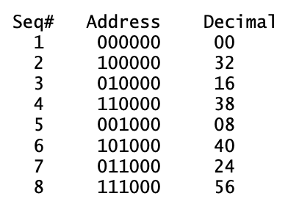
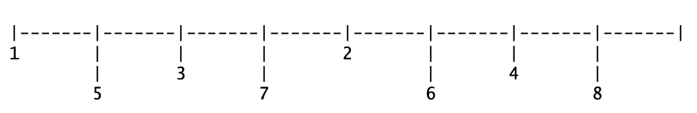
InBlock : Design
Conservation:
Stockpiling prevention with fee mechanism
Reclaim of unused addresses
Aggregation:
Preservation of the routing table limiting the number of ASes per prefix
Sparse allocation strategy
Notes:
--- Conservation. A main goal of the Internet resource allocation policies is to make a rational use of them and avoid wasteful practices.
---Aggregation. 60 s WITH CURRENT DIMENSIONS TABLES TO PROCESS ROUTES: LIMIT THE NUMBER OF ROUTES LOWER NUMBER OF PREFIX THE LOWER HARDWARE REQUIREMENTS --- ALLOCATION POLICIES IS TO REDUCE N PREFIX ADVERTISED BY FOSTERTING HIERACHICAL ALLOCATION. ENCURAGES PROVIDER BASED ADDRESS AGGREGATION as a preferred choice, by giving large address blocks of so-called Provider Aggregatable (PA) addresses to network providers, which in turn suballocate them to end users. --- In this way, the routes to many different end users can be advertised by a single announcement that encompasses the address space of the suballocated blocks, thus reducing the number of entries to store and process in the core routers.

Slide 14
InBlock : Design
Registration:
Cryptographic link between the resource holder and the account to manage the routing information via blockchain.
Stronger privacy features than the current IANA-RIR system.
Minimized Overhead:
Maintaince cost affordable
Time-scale operations InBlock vs current system: minutes vs days/weeks.
Notes:
Registration. Contact and other information to be REGISTERD SERVING FOR troubleshoot connectivity incidents. The current Internet Assigned Number Authority (IANA)/RIR based system maintains both a PRIVATE AND PUBLIC DATABASE with information regarding the allocations: This typically involves a contract which includes detailed contact information. --- It can be USED FOR LEGAL In addition, the party obtaining the resources may use any of the available Internet Routing Registry (IRR) to publish contact and technical information related to the resources. However, the information stored in the IRR system is often incomplete or inaccurate [52].
Minimized overhead. The allocation system should work with as little overhead as needed to fulfil its function.

Slide 15
InBlock : Design
Comparison of adverse actions against the RPKI and the InBlock
Adverse Action | RPKI | InBlock LIR
Deletion | Publications Point, Parent CA | 51% Attack
Suppression | Publications Point, Parent CA | 51% Attack
Corruption | Publications Point, Parent CA | 51% Attack
Modification | Private Key, Parent CA | Private Key
Revocation | Private Key, Parent CA | Private Key
Injection | Private Key, Parent CA | Private Key
Notes:
DIFFERNCE is that in the case of the RPKI, all these actions can be performed by a parent CA, while this is not possible in the InBlock, as InBlock does not rely on a hierarchical structure. Blockchain Not limited to a reduced set of publications points
1) Deletion: THE TAMPERING OF BLOCKCHAIN BLOCK 2) Suppression: This action can be achieved if the attacker controls at least 51% of the mining power of Ethereum [13]..
3) Corruption: Because every Ethereum full node validates all the transactions included in all the blocks before propa- gating the new block, performing this action would require to compromise all full nodes in the blockchain to publish invalid information.
4) Modification: To add a new transaction that modifies the information of an attestation contained in the InBlock, the at- tacker needs to compromise the private key of the affected LIR. The effort to compromise the private key of the holder of the resources is equal in the InBlock and the RPKI
5) Revocation: To revoke an existing attestation in the In- Block, the attacker must compromise the LIR’s private key.
6) Injection: Similarly to the two previous attacks, this is feasible only by compromising the LIR’s private key.
Registration:
This means that any other party accessing to the blockchain can verify that the contact and routing policy information is authorized by the assignee of the Internet resources.
In summary, InBlock provides stronger privacy fee
While still enabling resource holders to voluntarily provide contact and routing information for operational purposes.

Slide 16

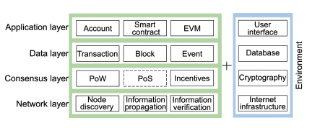
InBlock : Design
Ethereum
Public & Community Driven
Clean layered architecture
Secure Bootstrapping
[7]
Notes:
InBlock is agnostic to the blockchain mechanisms and automatically benefits from its evolution which is taken care by the community.
Clean architecture with layered design that separates the blockchain from the registry service.
Fast development and deployment, as we only need to focus in the design and the implementation of the registry service.
Secure bootstrapping, i.e., a secure blockchain from the start of InBlock. The security is given by the amount of computational power already spent in the chain

Slide 17
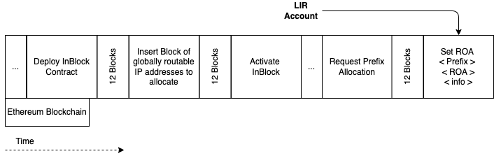
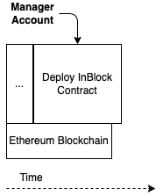
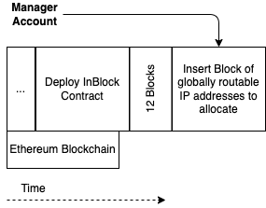
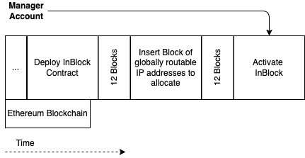
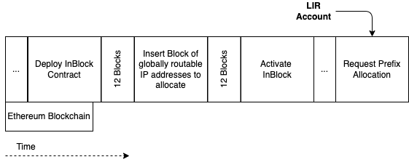
InBlock6 : Walk-through
Notes:
InBlock Rolse: MANAGER ; LIR ; END-USER ; THIRD PARTY
12 Block . The number of block indicate the amount of computational power that you need to spend to modify the information in way to modify he history
InBlock has a block of globally routable IP addresses to allocate. To request an address allocation, an entity transfers a fee to InBlock.
InBlock annotates in the blockchain the prefix allocated to the requester, which is public accessible.
The human action is limited to the initial definition of the allocation rules
Not controlled by any single entity, so when applied to IP address management, it results in a mechanism that reflects more accurately the current Internet reality as a global network.
Clear and Transparent rules without any kind of human discretion
Reduced legal uncertainty costs for the organizations depending on the Internet for their activities.
Address conservation is preserved by a fee mechanism which mimics the current fees charged by the RIRs to the recipients of IP address allocations.

Slide 18
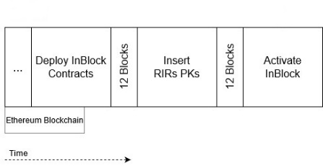
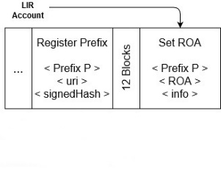
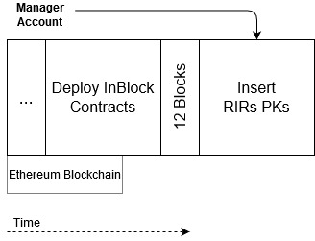
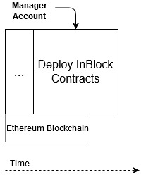
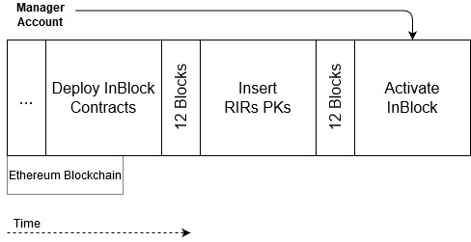
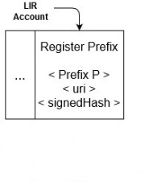
InBlock4 : Walk-through
Notes:
InBlock Rolse: MANAGER ; LIR ; END-USER ; THIRD PARTY
LIR Register Prefix instead of requesting a new allocation
InBlock4 resolve a different problem compared to InBlock6. I
nBlock 4 provides a means to register already assigned resources into the blockchain. IPv6 a lot
IPv4 scarcity

Slide 19
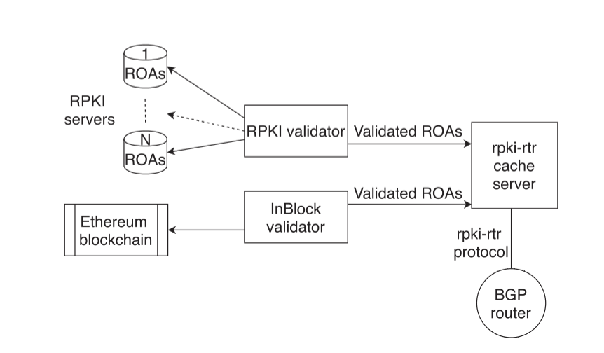
InBlock : Validation
Notes:
InBlock validator is listening to ethereum blockchain events. The incremental differences are managed throught events

Slide 20
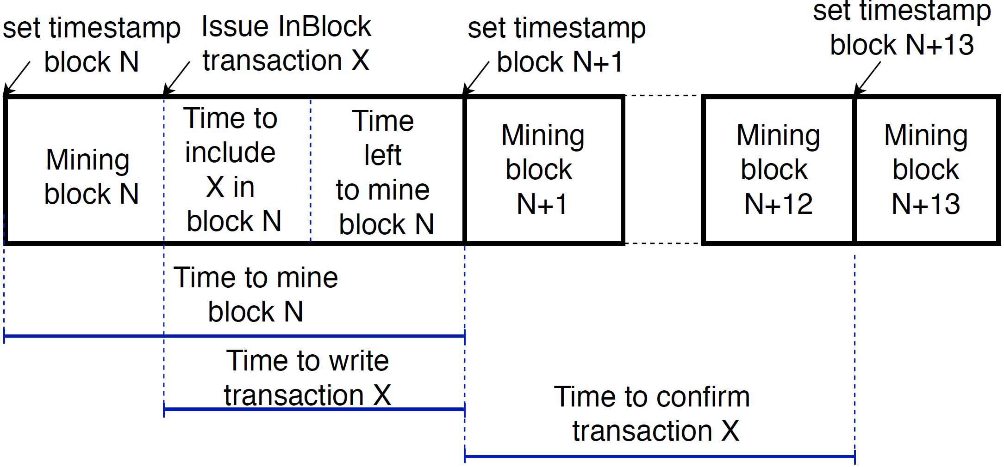
InBlock : Evaluation
Timescale
Result
Max t W | Med t W | Max t C | Med t C
144.5 s | 31.5 s | 349.12 s | 191.23 s
Notes:
Metric 1 : TimeScale .
RIR: From day to weeks to finalize the assignment process.
Experiment Setup: MAINNET 50TX each of the InBlock functions spanned over 10h

Slide 21
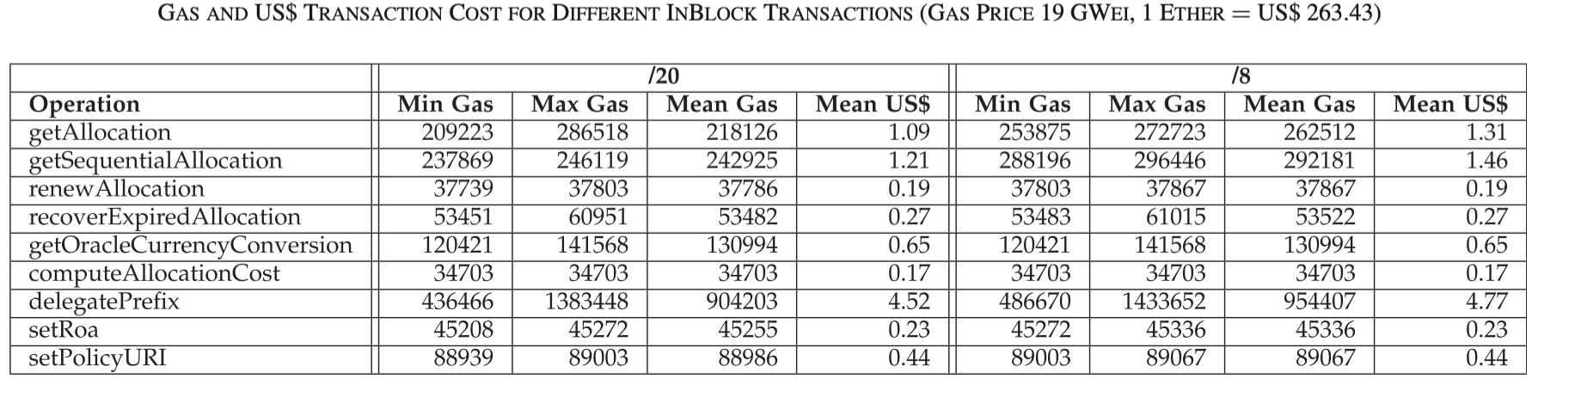
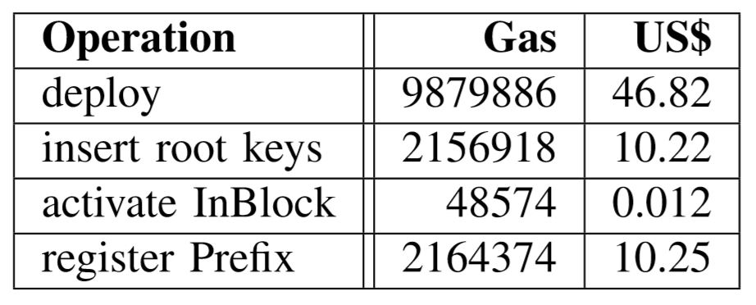
InBlock : Evaluation
Transactions Price
InBlock6
Price in ether = gasUsed * gasPrice
InBlock4
1 Ether= 250 $
gasPrice: 19Gwei
Notes:
Metric 2 Transaction Price Gas is the unit Ethereum uses to express the cost in terms of computation and storage of a given call or transaction. PRICE WE PAY TO GET CODE EXECUTED IN THOUSAND OF REMOTE COMPUTER GasUsed: Gas required by every operation written in the contract
GasPrice: Price that the user is willing to pay for every operation to get its transaction mined
Price in ether = gasUsed * gasPrice.
Deploy: 12.18 MGAS, with an estimated cost of US$ 60.96. Experiment Setup: Deployment on Mainnet. 50 transactions for each of the InBlock functions spanned over 10h

Slide 22
Outiline
InBlock
InBlockIPv6 Proof of Concept
InBlockIPv4 Proof of Concept
IRB & ASIRIA
Internet Routing Blockchain
Autonomous System Internet Registry Inference for path Authorization
Conclusions & future work
Notes:
We have discussed design and implementation of InBlock, a Distributed Autonomous Organization (DAO) for managing IP addresses. The proposed approach uses blockchain technology to perform IPv6/IPv4 address registry functions.
---InBlock makes different trade-offs than the current hierarchical allocation system.
----First and most importantly, InBlock is not centrally controlled, but as any blockchain-based mechanism, it depends on distributed consensus.
----Second, InBlock operates completely autonomously, without any human intervention.
InBlock provides a distributed, automatic, irrevocable, tamper-free, publicly accessible and privacy-preserving resource allocation mechanism, designed with the appropriate (economic) incentives to enforce address conservation.
We show that the proposed InBlock design is able to perform the IPv6/IPv4 registry functions in an efficient manner, significantly reducing the operational costs compared to a traditional (human-based) registry and also reducing in orders of magnitude the time required to perform an allocation.
In addition, this solution is compatible with the cryptographic security architecture developed for the Internet routing system.
This approach provides clear and transparent rules without any kind of human discretion, and thus, it reduces legal uncertainty costs for the organizations depending on the Internet for their activities. Address conservation is preserved by a fee mechanism which mimics the current fees charged by the RIRs to the recipients of IP address allocations. In addition, InBlock provides the means
to become the authoritative database in which the assignee of the prefix can associate the basic information for the Internet routing system to operate, currently stored in the Internet Routing Registries [52], along with the cryptographic information that may be used to secure the routing system.
It is worth to note that InBlock is designed as an additional IPv6/IPv4 registry and not as a replacement for the current IANA/RIR based one.
The current hierarchical system has stood the test of time, and the ICANN plus RIR system provides services that are appreciated by the Internet community.
Therefore, we do not devise a migration strategy in which the information currently hold by the RIRs is transferred to a blockchain based mechanism.
We envision InBlock as just an alternative for organizations deeply concerned about the mismatch in jurisdictions, including the RIRs themselves, which may not want to be responsible for address allocations that are subject to legal processes either in their jurisdiction of in the area in which they operate.
As it is the case for most new disrupting technologies, there are many open questions about blockchains including how sustainable are they, how they will evolve, how secure are they, among many others. We now lie on a crossroad: we have a technology that has the potential to bring autonomous decentralized IP address management to the Internet, but it is still too immature to be fully adopted. On one hand, it is in the Internet’s genetic code to embrace innovation, but on the other hand, there is too much uncertainty about blockchains and too much at stake to simply give a step forward and adopt an Internet-wide Blockchain-based registry.
For the aforementioned reasons, we believe it would be beneficial for the Internet community to perform a series of experiments on decentralized Internet address management using the blockchain technology. The proposal is to allocate a small IP address block out of the global address space for an experiment and to create one or more blockchain-based organizations to manage the allocations out of that address block, with a predefined lifetime. Such an experiment would enlighten the community with a hands-on experience to inform future directions regarding decentralized Internet address management.
The rest of the design section is devoted to present the rationale for the design of InBlock. For doing this, we analyse each of the requirements for an address allocation system, and how they are fulfilled by InBlock.

Slide 23
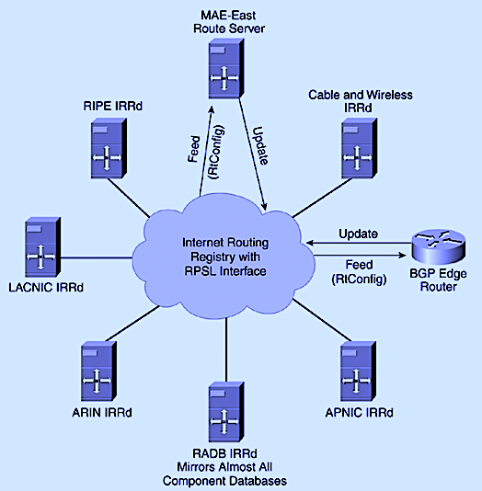
IRB & ASIRIA : Motivation
[8]
Notes:
Established in 1995 with the purpose of ensuring the stability and consistency of Internet-wide routing by sharing information between network operators. IRRs are distributed repositories, individually operated by different organizations, where ASes declare their routing policies
More than 34 different IRRs
Information stallness - incosistency
Policies expressed in Routing Policy Specification Language (RPSL) : Complex to extract ASes relationship
Blockchain Unique shared ledger for the decentralised management of the information stored in the IRRs
Globally distributed routing information database
This information can be used to perform route leak detection and prevention
. This information can be used to perform route leak detection and prevention. According to the current Mutually Agreed Norms for Routing Security (MANRS) guidelines [66], operators are encouraged to use the information available in the IRR to create filters that prevent route leaks. In [5], we have motivated and described how ASIRIA can use the information stored in IRRs to prevent and detect route leaks serving as a bootstrap for ASPA while ASes start to register their relationship policy or their client list in RPKI servers. In short each AS registers its routing policies in the IRR. When an AS receives a route, the router of the AS uses this information, according to the ASIRIA specification, to validate it. ASIRIA takes advantage of the valley-free properties of route propagation in the internet, so that it can determine if the route is a leak or not. This, combined with origin validation, provided by the RPKI, results in quite good protection. Using the IRRs may allow to bootstrap this process and provide the ability to validate a significant number of routes even when the ASes are not yet actively registering their relationships in RPKI servers. However, there are some limitations to overcome. In this section, we will present the shortcoming of these two solution, that will serve to motivate the work on the Internet Routing Blockchain (IRB) that we present in this thesis.
Established in 1995 with the purpose of ensuring the stability and consistency of Internet-wide routing by sharing information between network operators. IRRs are distributed repositories, individually operated by different organizations, where ASes declare their routing policies. This information can be used to perform route leak detection and prevention. According to the current Mutually Agreed Norms for Routing Security (MANRS) guidelines [66], operators are encouraged to use the information available in the IRR to create filters that prevent route leaks. In [5], we have motivated and described how ASIRIA can use the information stored in IRRs to prevent and detect route leaks serving as a bootstrap for ASPA while ASes start to register their relationship policy or their client list in RPKI servers. In short each AS registers its routing policies in the IRR. When an AS receives a route, the router of the AS uses this information, according to the ASIRIA specification, to validate it. ASIRIA takes advantage of the valley-free properties of route propagation in the internet, so that it can determine if the route is a leak or not. This, combined with origin validation, provided by the RPKI, results in quite good protection. Using the IRRs may allow to bootstrap this process and provide the ability to validate a significant number of routes even when the ASes are not yet actively registering their relationships in RPKI servers. However, there are some limitations to overcome. In this section, we will present the shortcoming of these two solution, that will serve to motivate the work on the Internet Routing Blockchain (IRB) that we present in this thesis.

Slide 24
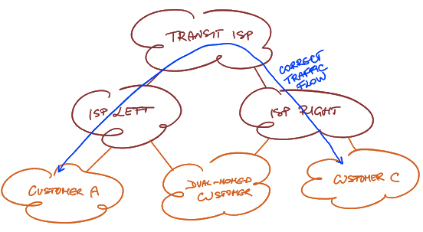
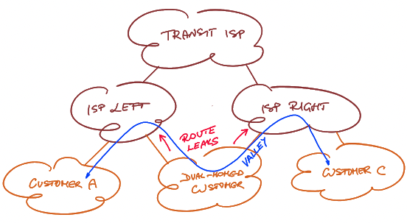
Route Leaks Detection and Prevention
IRB & ASIRIA : Motivation
Valley Free Property
«A route leak is defined as the propagation of a route beyond its intended scope» [11]
BGP Route Path: AS1 AS2 AS3 AS4 AS5
BGP Route Path: c2p c2p p2c p2c
Correct Traffic Flow : c2p c2p p2c p2c
[9]
Entering a valley due to a route leak : c2p p2c c2p p2c
Notes:
route leaks are the result of propagating routing information with a valid origin and acquired via a valid relationship that goes beyond the scope intended by the routing policies of the involved ASes.
The result of a route leak can be redirection of traffic
Leaks can be accidental or malicious but most often arise from accidental misconfigurations.
---BGP PATH SEQUENCE OF AS TRAVERSED FROM ORIGIN TO DESTINATION OF TRAFFIC
---BGP PATH AS SEQUENCE OF BUSINESS RELATIONSHIP BETWEEN TRAVERSED AS Valley free upstream followed by downstream only

Slide 25
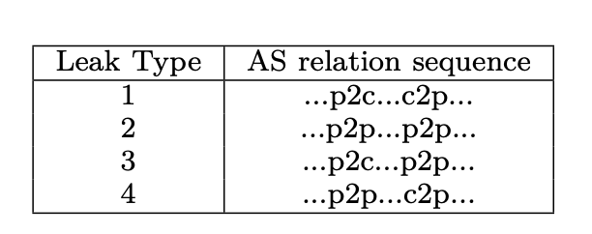
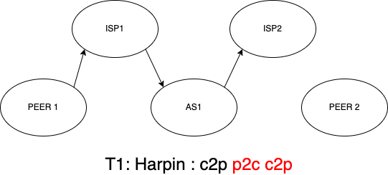
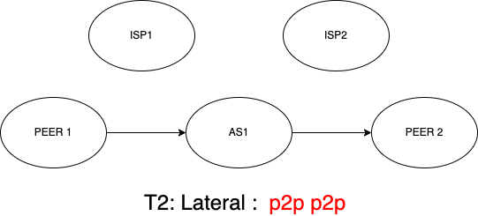
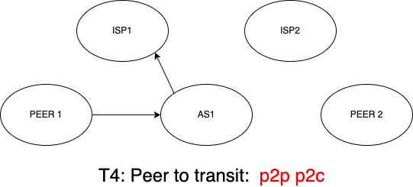
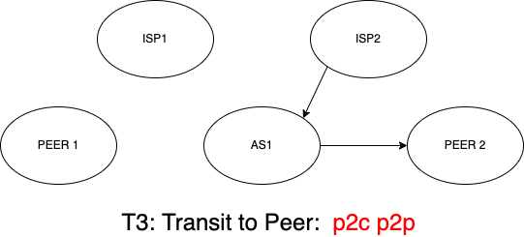
Route Leaks Detection and Prevention
IRB & ASIRIA : Motivation
[RFC 7908]
Notes:
Additionally, RFC 7908 defines route leaks of type 5 and 6,
but these leaks are related to mis-origination or re-origination of routes by the offending AS
can be prevented by existing techniques such as RPKI-based origin validation.
we only consider route leaks of types 1 to 4.
Type 1 - Hairpin: A (multihomed) client announces a route learned from one provider to another provider.
Type 2 - Lateral: An ISP announces a route learned from peer to another peer.
Type 3 - Transit to peer: An AS announces routes learned from a provider to a peer.
Type 4 - Peer to transit: An AS announces routes learned from a peer to a provider.

Slide 26
IRB & ASIRIA : Motivation
Provide a unique distributed registry for the management and storage of the resources registered in more than 34+ different IRRs
Provide a Route Leaks Detection and Prevention mechanism using the information stored in IRRs

Slide 27
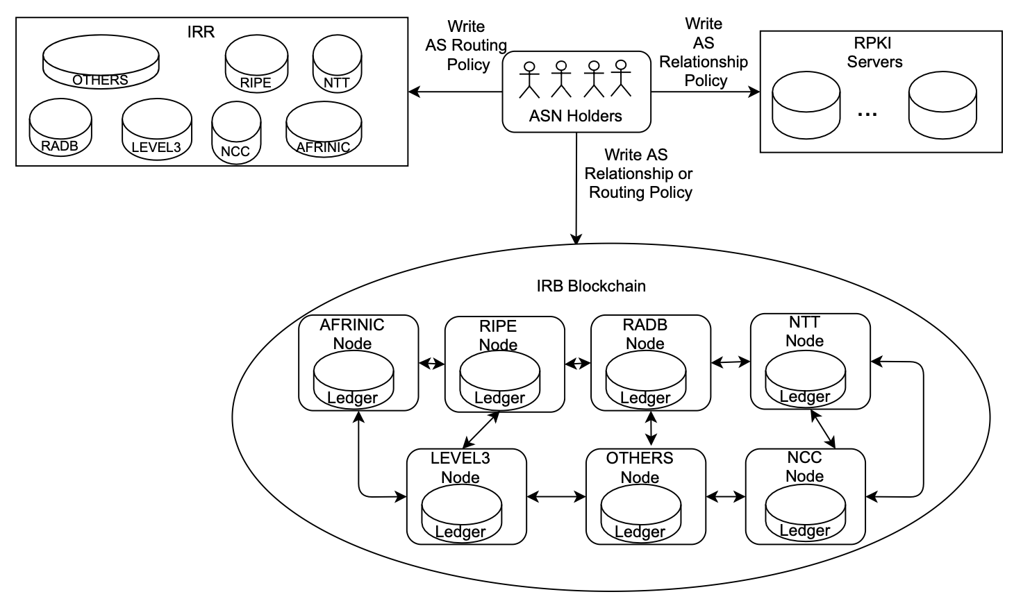
IRB : Design
Notes:
The IRB consortium can be started by a subset of the involved players such as RIRs, NIRs, ISPs or any interested organization
Hyperledger Fabric is the permissioned blockchain framework of choice
The IRB blockchain is a consortium run by independent organizations
The IRB blockchain can be set up in a customizable decentralized and permissioned fashion to meet the needs of participants

Slide 28
IRB : Design
Membership Management
Organizations
Clients
ASN holder has an Resource Public Key Infrastructure (RPKI) certificate associated to the ASN
ASN holder has obtained it from a RIR/NIR but does not have an RPKI certificate.
Notes:
Organisations are the ones running the network components of the blockchain, storing its data, validating and endorsing the transactions.
----UP to consortium through the Certificate Autority to manage organizations identities and membership.
-------Any legitimate holders of the AS can register relationships involving this AS number.
2 situations of an entity holding an AS number.
1) use private key associated to the public key contained in the certificate. each entity become a client of the peer organization ran by the RIR who issued the said certificate.
2)The second situation is when the holder of the ASN has obtained it from a RIR/NIR but does not have an RPKI certificate. In this case, the entity is client of the RIR that allocated the ASN and it is the RIR that validates that the allocation is legitimate using its own means.
In this case, the client will obtain a certificate from the peer organisation certification authority to be able to issue transactions in the IRB.
Any entity holding an Autonomous System (AS) number can become a client of the IRB. Only legitimate holders of the AS number resources can register relationships involving this AS number. This naturally implies that the IRB membership is tightly related to ownership of AS numbers. We consider two different situations of an entity holding an AS number.
The first situation is when the ASN holder has an Resource Public Key Infrastructure (RPKI) certificate associated to the ASN [110]. In this case, the ASN holder can prove that it is the legitimate holder of the ASN by exhibiting control of the private key associated to the public key contained in the certificate. So, any entity having an RPKI certificate should automatically be accepted as a client in the IRB and be allowed to issue transactions affecting that ASN. In particular, each entity having an RPKI certificate attesting the ownership of an Autonomous System Number (ASN) issues become a client of the peer organization ran by the RIR who issued the said certificate.
The second situation is when the holder of the ASN has obtained it from a RIR/NIR but does not have an RPKI certificate. In this case, the entity is client of the RIR that allocated the ASN and it is the RIR that validates that the allocation is legitimate using its own means. In this case, the client will obtain a certificate from the peer organisation certification authority to be able to issue transactions in the IRB.

Slide 29
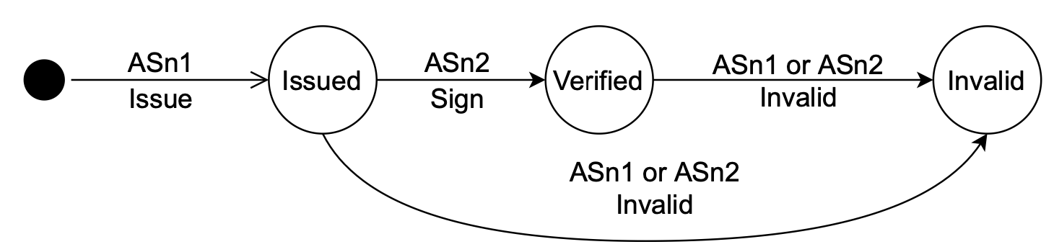
IRB : ASN pair asset description
IRB : Design
ASN PAIR fields:
State
Autonomous System Number 1
Autonomous System Number 2
Relationship
securityLevel

Slide 30
IRB : Dataset & Experiments
AS relationships inferred by CAIDA combined with data from IANA regarding the ASN assignments to RIRs
The total number of unique ASN : 72K
The total amount of records to manage: 915K
Time of information retrieval is linear for bulk downloads [0.1s , 14s]
Memory size is linear [0 and 200 Mb]
Notes:
Cooperative Association for Internet Data Analysis (CAIDA)
----The resulting dataset is the information regarding the AS relationship depicted per RIR. As this information is divided in 5 organizations and it comes from data that are mainly considered as a Ground truth, we can simulate a close-to-real scenario for testing the IRB blockchain as a consortium run by RIRs.
----are directly proportional to the number of records and they increase linearly

Slide 31
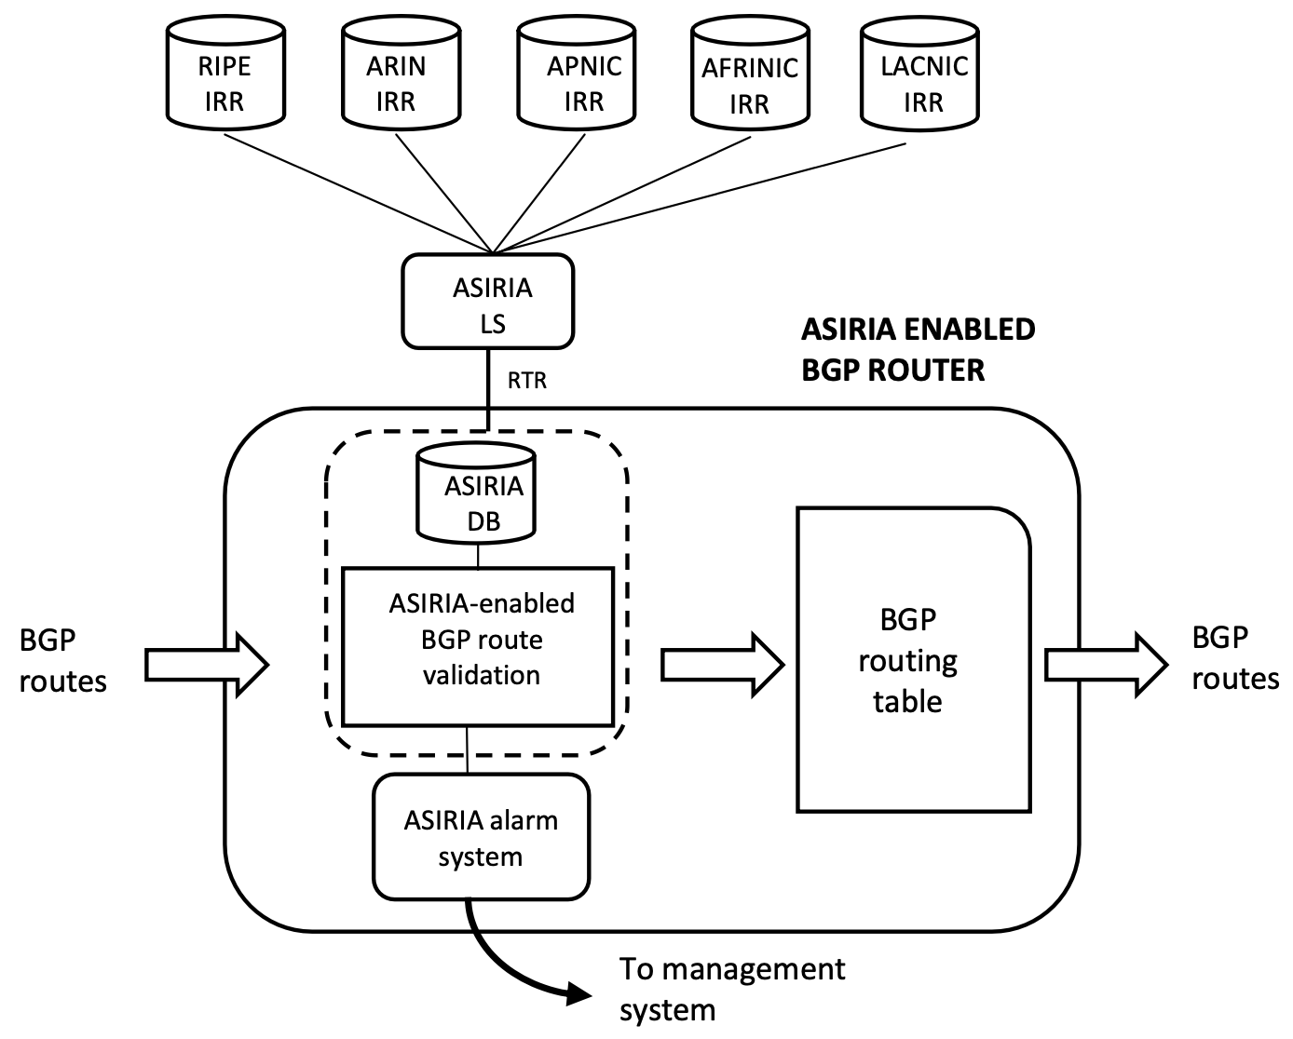
ASIRIA : Design
Notes:
ASIRIA is a mechanism for route leak detection and protection. Made 3 Components.
-----an algorithm to infer relationships between ASes from IRR
-----a mechanism running in the ASIRIA enabled routers that uses the inferred AS relationship to perform real time detection of invalid routes
------an alarm system that detects leakage events.
Experiments to evaluate performace of every component.
Identifies leaked routes and drop list, instead of accept-list to deprefer routes alternative routes
Keeps track of the number of leaks detected and uses this information to build leakage alarm event with which feed the routers

Slide 32
ASIRIA : Design
C2P relationships conditions: tc1) aut-num: AS1; import: from AS2 accept filter != ANY tc2) aut-num: AS1; export: to AS2 announce ANY tc3) aut-num: AS2; import: from AS1 accept ANY
tc4) aut-num: AS2; export: to AS1 announce filter != ANY
P2P relationships conditions:
pc1) aut-num: AS1; import: from AS2 accept filter != ANY
pc2) aut-num: AS1; export: to AS2 announce filter != ANY
pc3) aut-num: AS2; import: from AS1 accept filter != ANY
pc4) aut-num: AS2; export: to AS1 announce filter != ANY
Notes:
The inference algorithm extracts C2P and P2P relationships from the IRR using the import and export family of attributes present in the aut-num objects.

Slide 33
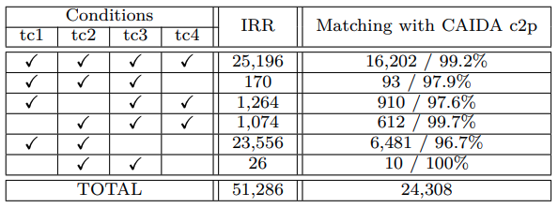
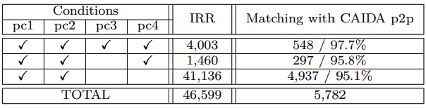
ASIRIA : Evaluation
Notes:
CAIDA Center for Applied Internet Data Analysis : Information regarding AS relationship as ground truth
The ASIRIA inference algorithm extracts C2P and P2P relationships from the IRR using the import and export family of attributes present in the aut-num objects.

Slide 34
ASIRIA : Dataset
Real RIS BGP route tables: 1601 monitors, 20 collectors
Full feeds rule
302 monitors with a mean number of 824,000 advertised prefixes and 105,000 different AS path routes.
The ASIRIA DB has 51K p2c and 46K p2p in IRR appearing in 29.8K relationship of RIS BGP routing tables analyzed.
7.9% of 373K the total number of different AS pairs appearing in the RIS BGP tables
Notes:
Routing Information Service
Tables containing at least the 75% of the maximum number of prefixes observed in any RIS BGP feed
This represent the 7.9%

Slide 35
ASIRIA : Evaluation metrics
False Positive Rate
Sensitivity
Alarm System Sensitivity
Notes:
-----The false positive ratio, the number of valid routes identified as leaks over the total number of valid routes, reflects the probability of a false positive, we determine an upper bound for this value.
-- Sensitivity: the ratio between the leaks detected and the total number of leaks, indicates how many of the actual leaked paths can be detected.
---------In addition, we compute the sensitivity of the ASIRIA alarm system for detecting leakage events, i.e. an event that generates a set of leaks. With the setted parameter

Slide 36
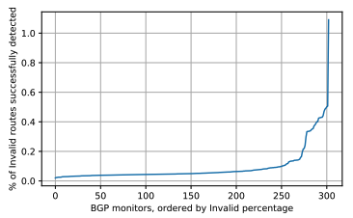
False Positive in ASIRIA leak detection
ASIRIA : Evaluation
Notes:
The mean number of routes marked by ASIRIA as a leak per monitor is 96.8 routes in steady state.
---We can compare this value with the mean number of routes that have two or more relationships identified per monitor, i.e., the routes for which it is possible to detect an invalid route, 8,491 routes.
----The ratio of false positives for this route set is 1.1%, and could serve as an estimation of the false positive ratio ASIRIA can achieve.
----This is consistent with previous work that has found that 1.5% of the IPv4 routes are valley routes, some of which would be detected as leaks by ASIRIA.
We next inspect the routes identified as invalid, and we study their variation over time. We search for the same routes in the routing tables of the same RIS monitors, 8 hours before and after. Most of the paths identified as invalid are stable and appear in the previous and subsequent routing table snapshots. More precisely, 95% of the routes marked as invalid observed at 08:00 were also present at 00:00, and the coincidence between 08:00 and 16:00 is 98%. We also consider the match with the routing tables captured 10 days after (2021-03-11, 08:00), to observe in this case a match of 85%. This suggests that most of the invalid routes of this set have not changed over time, probably indicating that they are legitimate routes (or at least, leaks that did not trigger any corrective action. This means that the false positive rate should be below the 1.1% upper-bound computed earlier. ASIRIA is designed to take into account a non-negligible positive rate as the one we obtain. As routes that are leaks are not discarded, but they are de-prioritized, they are still used when no better alternative is available. This ensures that customer prefixes included in the aforementioned 1.1% are always reachable either directly or through other providers. Thus, ASIRIA does not discard legitimate traffic when there are false positives.

Slide 37
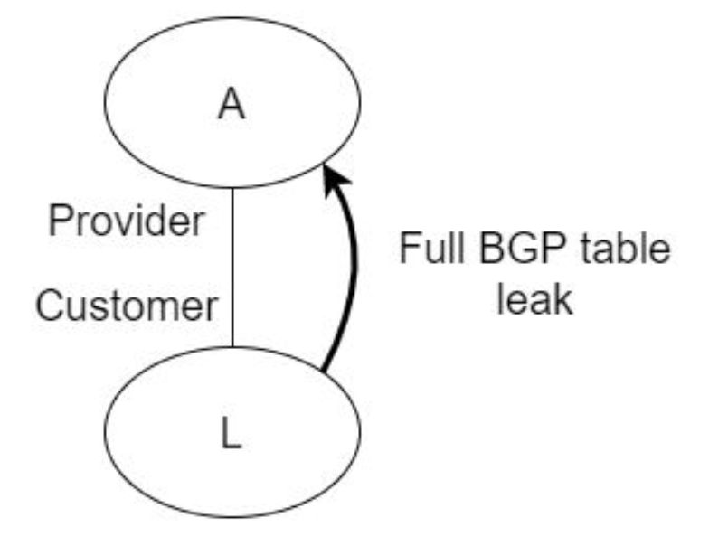
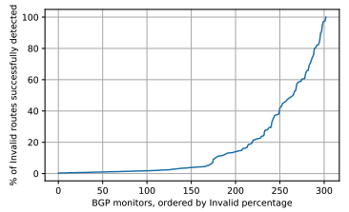
ASIRIA leak detection sensitivity
ASIRIA : Evaluation
Notes:
Customer AS L leaking its full BGP table to router A --- We compute the level of protection provided by ASIRIA for this scenario.
--- We use the BGP tables retrieved from RIS for L.
------When L advertises all its routes to A, only peers or providers of L are actual leaks. L’s own routes and the routes from its customers are legitimate announcements to A.
--------We identify all these routes using the relationships inferred by CAIDA to determine which neighbours of L are its customers and we remove them from the leak count. The remaining routes are considered to be leaks. We next compute the sensitivity of ASIRIA when detecting leaks in router A.
----In average across all the 302 experiments (each one corresponding to the leakage of the routing table of a different RIS monitor), the ASIRIA-enabled router can detect 17.7% of the routes leaked by the neighbour.
The distribution for the different experiments is shown and We observe that there are important differences between experiments regarding the leak detection capability. In the top 2% of cases, ASIRIA is able to detect more than 90% of the routes as leaks, and in 20% of the cases ASIRIA can detect at least 40% of the leaks. In all these cases, ASIRIA provides immediate significant gains. On the other end, the bottom 30% of the cases only detect 1.6% of the leaks.
The ratio of leaks detected for the other regions are: USA: 2.7%, ASIA: 5.9%, LACN: 9.2% and AFR: 7.4%. A

Slide 38
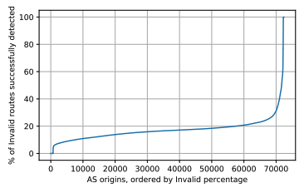
ASIRIA leak detection sensitivity
ASIRIA : Evaluation
A
Provider
BGP Table with
Specific AS Leak
Customer
L
Notes:
We next look into the performance of ASIRIA detecting leaks in case the neighbour leaks the routes originated from a specific origin AS.
The leakage is limited to the routes of a specific origin AS, instead of leaking the full routing table as we considered in the previous analysis, the median number of routes detected by ASIRIA is 16.7%.

Slide 39
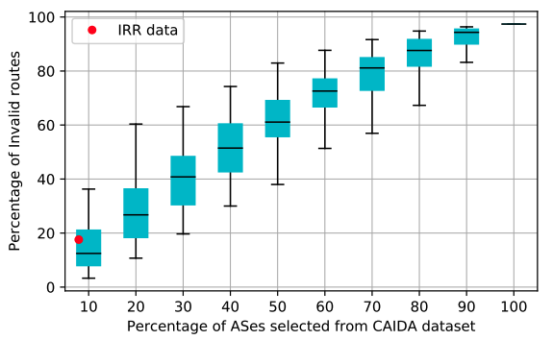
ASIRIA leak detection sensitivity
ASIRIA : Evaluation
Notes:
In the previous section, we observe that in some cases ASIRIA fails to detect a significant number of leaks.
-- no too many information in the IRR.
We analyse how ASIRIA’s performance improves as the number of relationships declared in the IRR increases.
We compute the evolution of the leak detection sensitivity of ASIRIA as a function of the number of AS relationships declared in the IRR.
---CAIDA. We perform 10 batches of 100 experiments each. For each of the batches, we include an extra 10% of the information about AS relationships available in CAIDA,
---Then we use the same methodology described in the previous section: we compute the fraction of detected route leaks for each experiment.
This allow us to gain an insight of how ASIRIA’s route leak sensitivity could evolve as the IRR gets populated.
almost all routes are identified as leaks when the complete CAIDA relationship dataset is used.

Slide 40
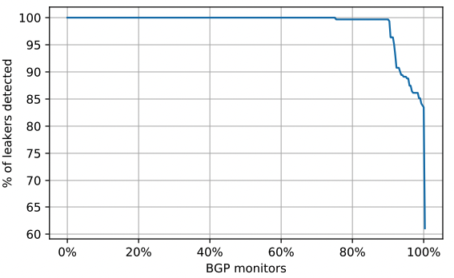
ASIRIA alarm system sensitivity
ASIRIA : Evaluation
Th within a short period of time p (i.e., at least Th% increase p minutes or less).
Th set to 100%
p set to 5 minutes
Notes:
An ASIRIA alarm is triggered when the number of leaks present in the BGP routing table of the ASIRIA enabled router increments beyond a configured threshold
---In order to set a value for Th, steady state is 96 Leaked state is 18454. th to be conservative 100%
--- P: it takes up to 60 seconds to receive and process a full routing table from a BGP peer in normal conditions. Distance → 5 minutes.
Compute number of false positives and detected leaks. We use all possible combinations of two RIS monitors, and we use one as the offending, i.e., the client AS leaking its full routing table, and the other as being the victim provider AS that receives -----For each combination, we compute if the ASIRIA alarm system using the configured threshold (100\% increase in the number of leaks) would indeed detect the leakage event.
Figure plots the distribution of the number of leakage events detected by the ISPs running ASIRIA.
-- We can see that 74% of the ISPs detect 100% of the leakage events, that 90% of the ISPs detect at least 99% of the leakage events and that 99.9% of the ISPs detect at least 83% of the leakage events.

Slide 41
ASIRIA : Evaluation
Route Validation Process Performance
Python single threaded code (Intel Core i7- 5600U CPU, 2.60GHz): 1.6 microseconds
625,000 routes can be validated per second.
During 2021
Mean number of BGP updates per day 50,000
The full BGP table accounts for around 900,000 prefixes
Notes:
We finally discuss the performance of the route validation process, to assess that it could be integrated in realtime route processing.
---every BGP update carries one route at most (or none, for messages only withdrawing routes), the whole number of updates for a day can be processed in less than a second.
---In case that the whole routing table is advertised (e.g., when a BGP session is established or when a full BGP table is leaked), the validation of all the routes involved would take 1.5 seconds. These datapoints suggest that validation rate is large enough for practical purposes.

Slide 42
ASIRIA : Evaluation
Effectiveness of mitgation:
Fast mitigation
Self-managed/operated
Ease of operating/troubleshooting.
Notes:
Route leak detection systems key characteristics
---Effectiveness of miitgation: ASIRIA allows 90% of the analyzed ASes to detect more than 99% of the leakage events. ASIRIA allows early adopters to detect 17% of leak The effectiveness of ASIRIA will increase as more ASes populate the IRR
--- Fast mitigation 5 min period, but if the number of invalid paths reached the configured threshold Th earlier, the detection occurs faster.
--- Self-managed/operated ASIRIA is that it runs locally and it is not a service provided by a third party Ease of operating/troubleshooting. Alarm System

Slide 43
Outiline
InBlock
InBlockIPv6 Proof of Concept
InBlockIPv4 Proof of Concept
IRB & ASIRIA
Internet Routing Blockchain
Autonomous System Internet Registry Inference for path Authorization
Conclusions & future work

Slide 44
Conclusions
Design and implementation of InBlock
Design and implementation of IRB
Design and implementation of ASIRIA
Notes:
-- We have presented the design and implementation of InBlock, a SCs framework capable of performing the IPv6 and IPv4 global registry functions without human intervention avoiding the control of any single entity. InBlock provides a adecentralised alternative trust model to the hierarchical one, currently implemented by the RPKI. Exibits Low operational costs and the time required to perform an address allocation is orders of magnitude lower than the operational times of a human operated address registry.
--- we have presented the Internet Routing Blockchain, an HF consortium blockchain based solution to preserve the distributed nature of IRRs which provides information consistency and stall-ness prevention by design. The data stored in IRB can be used by novel route leaks pre- vention solution such as ASPA and ASIRIA.
-- We presented ASIRIA, a route leak detection and protection mechanism based on IRRs. ASIRIA define a method to infer the AS relationships from the information With this information, it validates the AS path of the received BGP routes, identifying as leaks those that violate usual business rules. Leak routes are deprioritized over other routes and large variations in the number of detected leaks trigger an alarm indicating that a close AS may generating a leakage event

Slide 45
Output: Publications & Open-source
Stefano Angieri, Alberto García-Martínez, Bingyang Liu, Zhiwei Yan, Chuang Wang and Marcelo Bagnulo, "A Distributed Autonomous Organization for Internet Address Management», in IEEE Transactions on Engineering Management, vol. 67, no. 4, pp. 1459–1475, 2020.
Alberto García-Martínez, Stefano Angieri, Bingyang Liu, Fei Yang and Marcelo Bagnulo,
"Design and Implementation of InBlock—A Distributed IP Address Registration System", in IEEE Systems Journal, vol. 15, no. 3, pp. 3528–3539, 2021.
Stefano Angieri, Marcelo Bagnulo, Alberto García-Martínez, Bingyang Liu and XinPeng Wei,
"InBlock4: Blockchain-based Route Origin Validation", in IEEE INFOCOM 2020 - IEEE Conference on Computer Communications Workshops (INFOCOM WKSHPS), 2020, pp. 291–296
https://github.com/steang91/InBlock_Code/tree/IPv6
https://github.com/steang91/InBlock_Code/tree/IPv4

Slide 46
Output: Submissions & Open-source
Stefano Angieri, Marcelo Bagnulo, Alberto García-Martínez, "Internet Routing Blockchain: an Hyperledger Fabric consortium blockchain for Internet Routing Registries". This work has been submitted for publication.
Marcelo Bagnulo, Alberto García-Martínez, Stefano Angieri, Andra Lutu and Jinze Yang, "Practicable route leak detection and prevention with ASIRIA". This work has been submitted for publication.
https://github.com/steang91/HyperledgerFabric_RouteLeaks

Slide 47
Future work
Extend ASIRIA using Machine Learning (ML) algorithms to detect leaks using the partial information present in the IRR.
«Unstoppable Domains» [Jun 2020]
InBlock NFT Marketplace
Notes:
-----The ML system would take as input the routes detected as leaks by the current version of ASIRIA, and it could be used to infer whether other unmarked routes are potential leaks, improving the overall ASIRIA performance. The ML- based inference should only be applied to relationships not explicitly annotated by the ASes in the IRR, to preserve the ability of ASes to retain full control of the detection process over routes containing their relationships.
Unstoppable Domains propose new crypto domain names accessible with browser extensions.
NFTs are tokens that can be used to represent ownership of unique items. They can only have one official owner at a time and they’re secured by the blockchain of choice., More than 2 milions of registered domain. Unstoppable Domains is proving the NFT technology value outside of its main current employment field.
-- The employment of loanable NFT can solve several problems specifically related to the conservation and preservation of the IP address space while providing a simplified management of the resources.

Slide 48
Future work : InBlock Experiment
yearly fee is enough to deter stockpiling
addresses obtained from the InBlock are actually used in the Internet.
extra deaggregation is observed.
a secondary market of addresses emerges.
contact information is completed and updated
changes in Ethereum affect the InBlock service
Pool of globally unique addresses is needed: IETF, IANA, RIR, NIR
Notes:
As the blockchain technology is fairly new, constantly evolving and probably susceptible to bugs, and the IP address allocation apparatus is a cornerstone of the Internet, we are not proposing to create an operational IPv6/IPv4 registry using InBlock. Instead, we are promoting an experiment with a limited scope, to gain a better understanding of how blockchain technology can be used to provide registry services for Internet resources and moreover, if the notion of a distributed autonomous registry is feasible.
The experiment, by definition, has a limited lifetime. The lifetime should be defined in advance, before starting the experiment. A reasonable time frame could be five years.
If the experiment is a success, the lifetime of the experiment can be extended and the allocations made renewable for as long as the holders want to renew them. If the experiment is terminated, the allocations made through the InBlock should be transferred to one of the existent Internet registries upon its termination.
This would allow organizations participating in the InBlock experiment to avoid the cost of renumbering regardless the result of the experiment.
With this conditions, the InBlock experiment is likely to be more realistic, as more organizations may use the resources obtained through the InBlock in real operations.
The experiment should include some safeguards in case an unexpected behavior is observed. For instance, it would be beneficial to rate limit the number of allocations made. If the rate in the applications is excessive, the experiments should be paused and the control passed to human supervisors.
In order to run the InBlock experiment, a pool of globally unique addresses is needed. The organizations that can provide the required pool of addresses and run the experiment are:
Pool of globally unique addresses is needed:
The Internet Engineering Task Force (IETF) (80% of the IPv6 address space is "Reserved for the IETF", and it is up to the IETF to instruct Internet Assigned Number Authority (IANA) to allocate an address block for the InBlock experiment),
Internet Corporation for Assigned Names and Numbers (ICANN), through the IANA,
The RIRs, either one of them on its own, or jointly through the Number Resource Organization (NRO)
A National Internet Registry (NIR).

Slide 49
Thanks
Thanks for your attention!

Slide 50
References
https://www.ledger.com/academy/blockchain/web-3-the-three-blockchain-generations
https://www.statista.com/statistics/730838/number-of-daily-cryptocurrency-transactions-by-type/
https://alphapoint.com/es/the-defi-series-an-overview-of-the-ecosystem-and-major-protocols/
https://www.theblockcrypto.com/data/decentralized-finance/total-value-locked-tvl
https://www.caida.org/
https://dl.acm.org/doi/fullHtml/10.1145/3391195
https://www.usenix.org/legacy/events/sec06/tech/full_papers/lad/lad_html/originChange.html
http://etutorials.org/Networking/Integrated+cisco+and+unix+network+architectures/Chapter+10.+ISP+Connectivity+with+BGPv4-An+Exterior+Gateway+Path-Vector+Routing+Protocol+for+Interdomain+Routing/Route+Server+and+Routing+Registries/
https://blog.ipspace.net/2018/09/valley-free-routing.html
RFC7908
Notes:
Blockchains can be indeed public, private or permissioned. While in public blockchain everyone has the right to join, participate in the network and as well the ability to read information from the distributed ledger itself, in private or permissioned blockchains users must be authorized by the majority or by a predefined subset of the peers to accomplish a set of pluggable operations.
We now discuss the technological aspects related to the specific framework we have used for the solution that we propose in this research work, Ethereum and HF.

Slide 51
References
https://www.forbes.com/sites/forbesbusinesscouncil/2020/09/28/what-makes-a-blockchain-project-successful/?sh=161db5812b44
https://crypto.news/average-eth-gas-fee-reached-new-ath-amid-trading-surge/
https://www.statista.com/statistics/1221821/gas-price-ethereum/
Notes:
Blockchains can be indeed public, private or permissioned. While in public blockchain everyone has the right to join, participate in the network and as well the ability to read information from the distributed ledger itself, in private or permissioned blockchains users must be authorized by the majority or by a predefined subset of the peers to accomplish a set of pluggable operations.
We now discuss the technological aspects related to the specific framework we have used for the solution that we propose in this research work, Ethereum and HF.

Slide 52
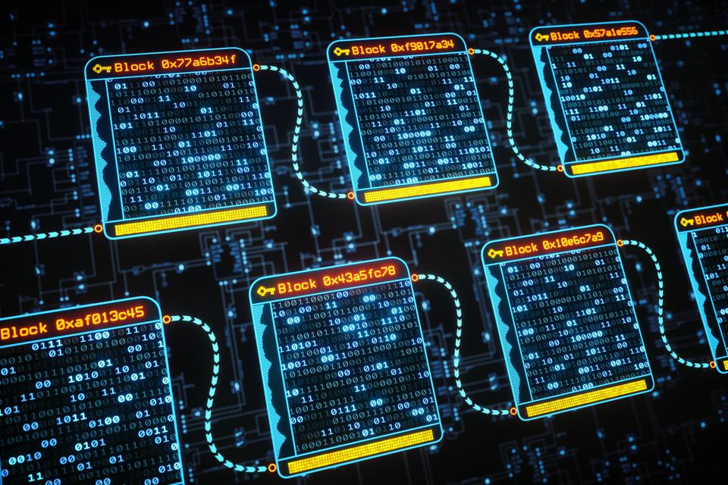
The Blockchain Technology
[11]
Notes:
The blockchain or distributed ledger technology is a composition of three leading technologies:
Peer-to-peer network that contains a shared ledger which thus is replicated in every nodes of the network
Distributed Consensus Mechanisms to rule the validation and the addition of new blocks of the network
Hashing and Public Key Cryptography. While the hashing provides immutability to the network, the PK is used to produce a secure digital identity reference for authorizing and controlling transactions.
Each individual participating in the network is identified by a couple of keys, a private key and a public key, which are used to produce a secure digital identity reference for authorizing and controlling transactions.
All the information is stored in all the nodes composing the blockchain peer-to-peer network.
The consensus is an emerging artifact that represents the agreement reached by more than thousands of nodes on the blocks added to the blockchain.
The addition of new valid blocks is determined through a distributed consensus mechanism.

Slide 53
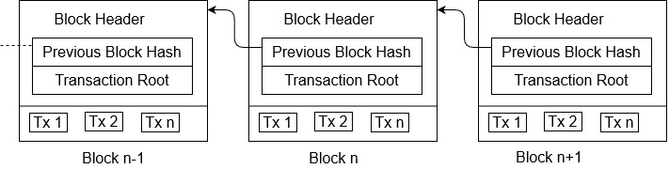
The Blockchain Technology
The Blockchain Technology
An immutable distributed ledger that records validated transactions permanently without the need of a trusted third party
Composed of an append-only list of blocks, securely linked between each other through cryptography
Notes:
Any alteration of the information contained in Block N lead to the break of the hash link contained in Block N+1, which is pointing the Block N.
The hash structure of the blockchain makes it computationally unfeasible to alter the data of one block without the manipulation of all subsequent blocks. Tampering the ledger, then, requires both the collusion of the majority of the network and an enor- mous amount of computational power to rebuild the chain from the replaced block. This is the sense in which we interpret the immutability of the blockchain.

Slide 54
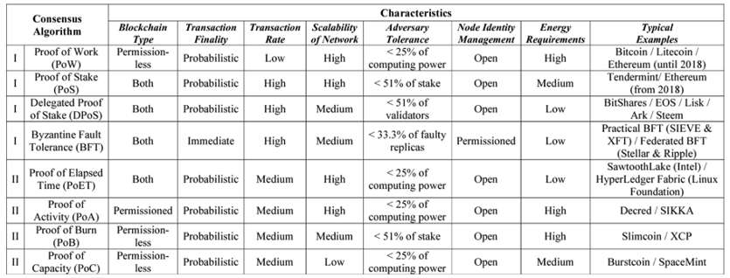
Consensus Algorithm Comparison
Notes:
Blockchains can be indeed public, private or permissioned. While in public blockchain everyone has the right to join, participate in the network and as well the ability to read information from the distributed ledger itself, in private or permissioned blockchains users must be authorized by the majority or by a predefined subset of the peers to accomplish a set of pluggable operations.
We now discuss the technological aspects related to the specific framework we have used for the solution that we propose in this research work, Ethereum and HF.

Slide 55
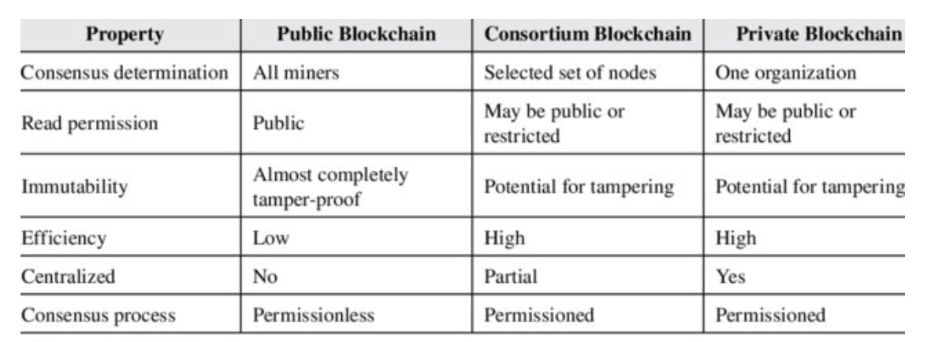
Blockchains : Public vs Consortium vs Private
Notes:
Blockchains can be indeed public, private or permissioned. While in public blockchain everyone has the right to join, participate in the network and as well the ability to read information from the distributed ledger itself, in private or permissioned blockchains users must be authorized by the majority or by a predefined subset of the peers to accomplish a set of pluggable operations.
We now discuss the technological aspects related to the specific framework we have used for the solution that we propose in this research work, Ethereum and HF.

Slide 56
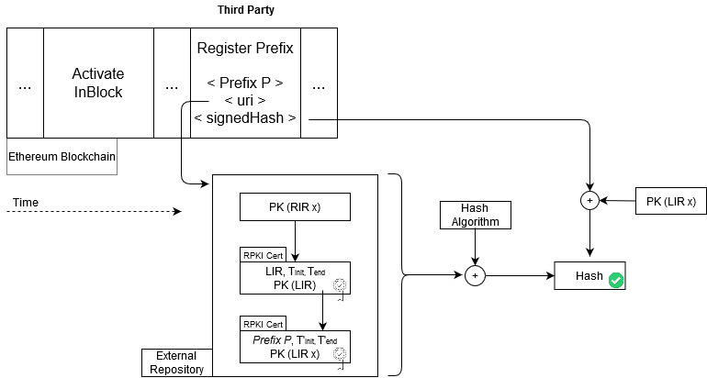





InBlock4 : Validation

Slide 57


Gas
Ethreum Historical Average Gas Price
Ethereum Gas
[12]
Price in ether = gasUsed * gasPrice
[13]
Notes:
Gas is the unit Ethereum uses to express the cost in terms of computation and storage of a given call or transaction.
GasUsed: Gas required by every operation written in the contract
GasPrice: Price that the user is willing to pay for every operation to get its transaction mined
Price in ether = gasUsed * gasPrice.
SoftFork London : Burn Gas fee
3rd Generation solutions : Incrementing the throughput
At the time of writing, Ethereum averaged $53 million in daily fee revenue. Bitcoin’s daily revenue was just over $1Million.

Slide 58

Hints
Distribution of number of blocks allocated up to May 2018, per block size.
Notes:
Blockchains can be indeed public, private or permissioned. While in public blockchain everyone has the right to join, participate in the network and as well the ability to read information from the distributed ledger itself, in private or permissioned blockchains users must be authorized by the majority or by a predefined subset of the peers to accomplish a set of pluggable operations.
We now discuss the technological aspects related to the specific framework we have used for the solution that we propose in this research work, Ethereum and HF.

Slide 59

IRB : Design
[11]
Notes:
Organisations are the ones running the network components of the blockchain, storing its data, validating and endorsing the transactions.
The organizations consortium is in charge of managing organizations identities and membership
The consortium, composed of the organizations bootstrapping the IRB, is in charge of managing organizations identities and membership. This means, that it is the consortium of organisations who decide to accept new peers. As example a new organization must be approved by at lest n/2 +1 of the total set of organizations to join the IRB. The specifics about how this is done is out of the scope of this work. The bootstrapping of the consortium requires an initial set of organisations to agree to build the IRB, for which a good candidate set would be a subset of the RIRs as it has been simulated in this work.
Established in 1995 with the purpose of ensuring the stability and consistency of Internet-wide routing by sharing information between network operators. IRRs are distributed repositories, individually operated by different organizations, where ASes declare their routing policies. This information can be used to perform route leak detection and prevention. According to the current Mutually Agreed Norms for Routing Security (MANRS) guidelines [66], operators are encouraged to use the information available in the IRR to create filters that prevent route leaks. In [5], we have motivated and described how ASIRIA can use the information stored in IRRs to prevent and detect route leaks serving as a bootstrap for ASPA while ASes start to register their relationship policy or their client list in RPKI servers. In short each AS registers its routing policies in the IRR. When an AS receives a route, the router of the AS uses this information, according to the ASIRIA specification, to validate it. ASIRIA takes advantage of the valley-free properties of route propagation in the internet, so that it can determine if the route is a leak or not. This, combined with origin validation, provided by the RPKI, results in quite good protection. Using the IRRs may allow to bootstrap this process and provide the ability to validate a significant number of routes even when the ASes are not yet actively registering their relationships in RPKI servers. However, there are some limitations to overcome. In this section, we will present the shortcoming of these two solution, that will serve to motivate the work on the Internet Routing Blockchain (IRB) that we present in this thesis.

Slide 60

ASIRIA leak detection sensitivity
ASIRIA : Evaluation
Notes:
We next look into the diversity of the impact on ASIRIA’s performance depending on which ASes declare their relationships. That is, we look whether there is a small set of ASes that, if they declared their relationships, ASIRIA’s performance would improve significantly. We compute the frequency in which the pairs of ASes are present in the AS path of the BGP routes present in the RIS routing tables. We identify all the AS pairs that appear in the AS path of every route and were not registered in the IRR, and we count the number of occurrences of each pair. Then, we order the AS pairs by decreasing frequency. Thus, the first AS pair has the potential (if annotated as c2p or p2p) to invalidate the larger number of routes, compared to the annotation of the relationships other less frequent AS pairs, etc. We present in Figure ?? the number of routes identified as leaks as each AS pair is being annotated. There are 363K different pairs for 26.2M routes. The distribution is highly skewed, as annotating a few pairs results in a large fraction of the routes being tagged as Invalid. For example, the first AS pair results in 1.5% of invalid routes, the top 10 pairs in 9.6% and the top 1000 pairs in 83.6% (i.e., annotating a 0.28% of the pairs allow detecting 83.6% of the leaked routes). The most frequent pairs appearing in the routes correspond mostly to interconnections between ASes up in the routing hierarchy: in the top 20 pairs, we observe 23 occurrences of ASes in the top 10 of CAIDA’s AS rank [?]. In this ranking, ASes ordered by their customer cone size, i.e., the number of their direct and indirect customers. This indicates that promoting the annotation of the interconnections between large providers would provide a large return in terms of the ability to detect routing leaks.

